Slide 1
Example Problem: 2D IMPES and SS w/o Capillary Pressure or Gravity
April 18, 2019

Slide 2
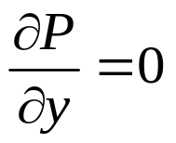
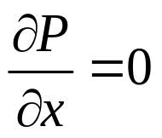
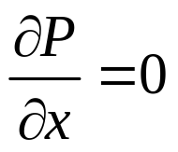
Simple 2D Geometry: 3 wells and no-flow boundaries
q_{prod2 (BHP)}
NX = 3
NY = 3
q_{inj}
q_{prod1}
j
i

Slide 3
Reservoir Input
Reservoir and Fluid Properties
L = 1200 feet
W = 600 feet
h = 200 feet
φ = 0.26
Kx = 1800 mD
Ky = 1800 mD
c_{f} = 3.0 E-06 psi⁻¹
c_{w} = 2.0 E-06 psi⁻¹
c_{o} = 5.0 E-06 psi⁻¹
μ_{w} = 1.0 cp
μ_{o} = 5 cp
Bw = Bo = 1
Well Properties
Q_inj = 3000 bbls/day
Q_prod = 2000 bbls/day
Q_prod2 = 800 psi BHP
r_{w} = 0.5 feet
s = 0
Initial Conditions
P_init = 1000 psi
Sw_init = 0.2
Numerical Properties
NX = 3
NY = 3
Δt = 0.1 days
NO CAPILLARY PRESSURE or GRAVITY

Slide 4
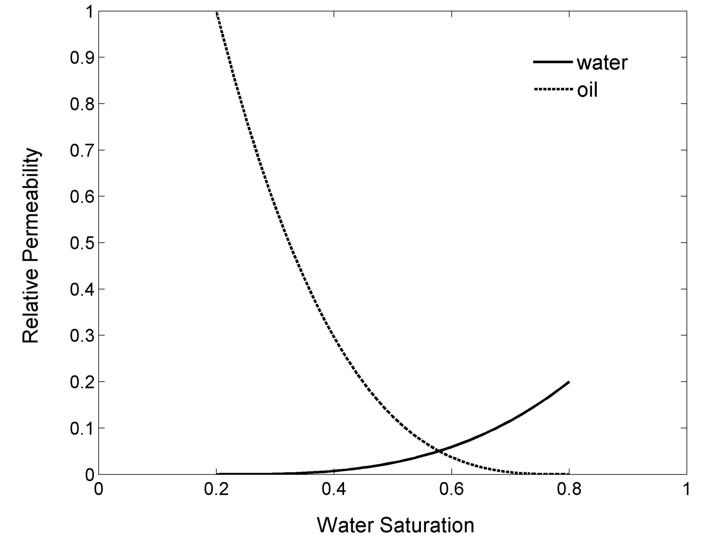
Relative Permeability Curves
k_{rw}= 0.2*S³ and k_{ro}= (1-S)³
S= (S_{w}-S_{wr})/(1-S_{wr}-S_{wi})
k_{rw}=rel perm of wetting phase k_{ro}=rel perm of nonwetting phase S_{w} = saturation S_{wr} = residual saturation S_{wi} = init saturation

Slide 5
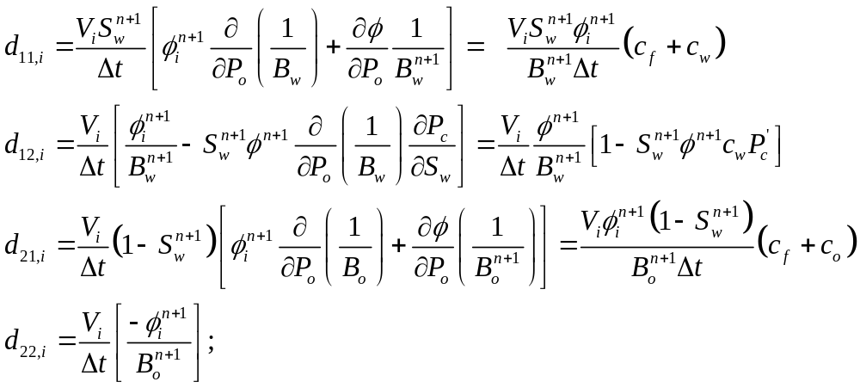
The “d” coefficients are given below
In general, all of the “d’s” vary from block-to-block and also are functions of time because S_{w}, etc. vary with space and time.

Slide 6
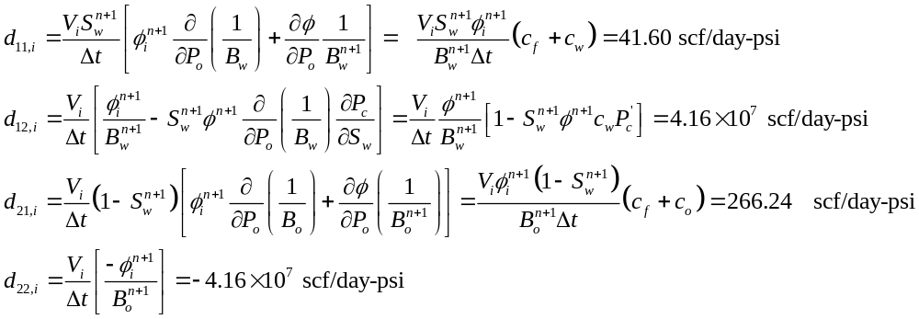
Each block has the same properties at t=0 (Sw=0.2)

Slide 7
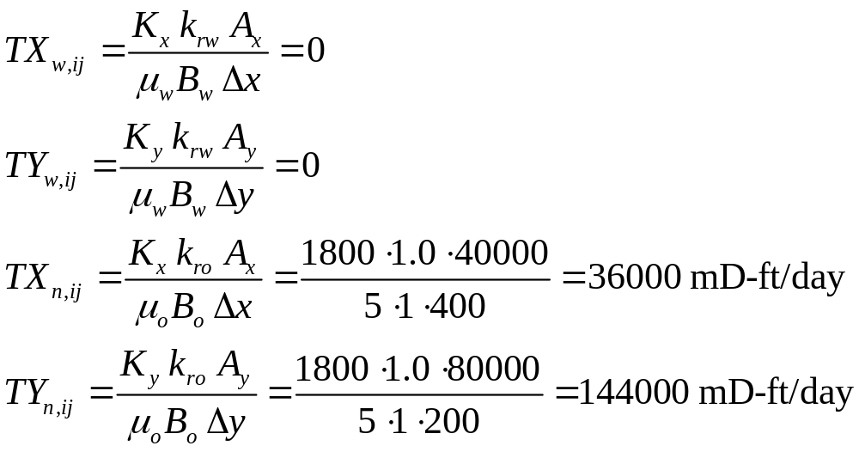
Each Block has same Transmissibility everywhere at t=0
Permeability and grid sizes uniform – no harmonic mean
Saturation (and relative perm) uniform - no upwinding (YET)
Half T’s same as block T’s except at boundaries

Slide 8
IMPES METHOD

Slide 9
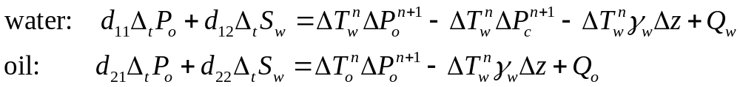
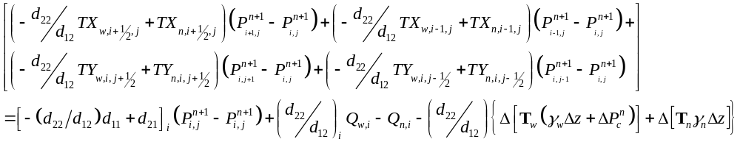
Pressure Equation for Each Block
Phase Mass Balances in short-hand
i,j
Overall Mass Balance found by adding water and oil balances
In-out of water + oil
Accumulation
Sources/sinks
Gravity and Cap Pressure
Expanding out the Transmissibility terms

Slide 10
Block 1,1 (L=1)
q_{prod2}
q_{inj}
q_{prod1}
j
i
No gravity or capillary pressure
Half transmissibilities are 0 on the left and botton
All wetting-phase tranmissibilities are 0 (Sw=Swr)
Qw =0 because Sw=Swr (fractional flow is zero)
Plugging in the numbers (note: units not correct)

Slide 11
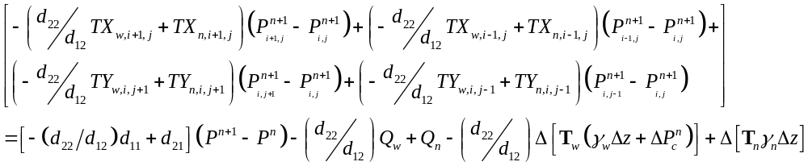
Block 2,1 (L=2)
q_{prod2}
q_{inj}
q_{prod1}
j
i
No gravity or capillary pressure
Half transmissibilities are 0 on the bottom
All wetting-phase tranmissibilities are 0 (Sw=Swr)
Qw =Qn=0
Plugging in the numbers (note: units not correct)

Slide 12
Block 3,1 (L=3)
q_{prod2}
q_{inj}
q_{prod1}
j
No gravity or capillary pressure
Half transmissibilities are 0 on the bottom and right
All wetting-phase tranmissibilities are 0 (Sw=Swr)
Qw =Qn=0
i
Plugging in the numbers (note: units not correct)

Slide 13
Block 1,2 (L=4)
q_{prod2}
q_{inj}
q_{prod1}
j
i
No gravity or capillary pressure
Half transmissibilities are 0 on the left
All wetting-phase tranmissibilities are 0 (Sw=Swr)
Qw =Qn=0
Plugging in the numbers (note: units not correct)

Slide 14
Block 2,2 (L=5)
q_{prod2}
q_{inj}
q_{prod1}
j
i
No gravity or capillary pressure
No boundaries
All wetting-phase tranmissibilities are 0 (Sw=Swr)
Qn=0, because we inject wetting phase
Plugging in the numbers (note: units not correct)

Slide 15
Block 3,2 (L=6)
q_{prod2}
q_{inj}
q_{prod1}
j
i
No gravity or capillary pressure
Half transmissibility on right is 0
All wetting-phase tranmissibilities are 0 (Sw=Swr)
Qw =Qn=0
Plugging in the numbers (note: units not correct)

Slide 16
Block 1,3 (L=7)
q_{prod2}
q_{inj}
q_{prod1}
j
i
No gravity or capillary pressure
Half transmissibility on left and top is 0
All wetting-phase tranmissibilities are 0 (Sw=Swr)
Qw =Qn=0
Plugging in the numbers (note: units not correct)

Slide 17
Block 2,3 (L=8)
q_{prod2}
q_{inj}
q_{prod1}
j
i
No gravity or capillary pressure
Half transmissibility on top is 0
All wetting-phase tranmissibilities are 0 (Sw=Swr)
Qw =Qn=0
Plugging in the numbers (note: units not correct)

Slide 18
Block 3,3 (L=9)
q_{prod2}
q_{inj}
q_{prod1}
j
i
No gravity or capillary pressure
Half transmissibility on top and right is 0
All wetting-phase tranmissibilities are 0 (Sw=Swr)
Qw = 0 because Sw=Swr and Qn=J’(Pwf-Pij)
Plugging in the numbers (note: units not correct)

Slide 19
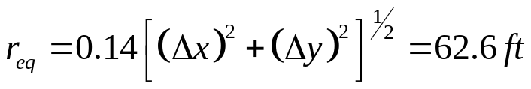
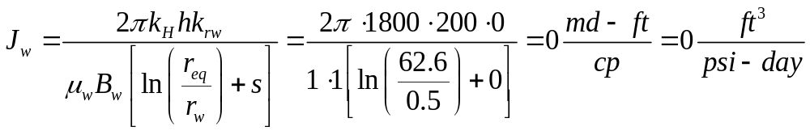
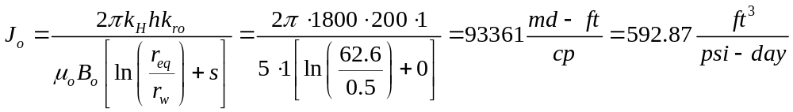
Productivity Indices
Peaceman Correction
Productivity Indices

Slide 20
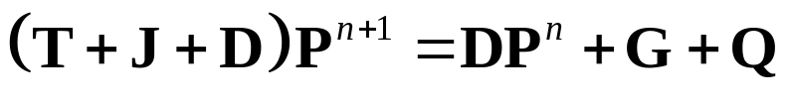
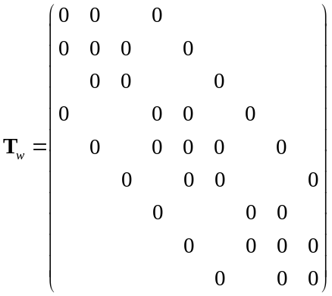
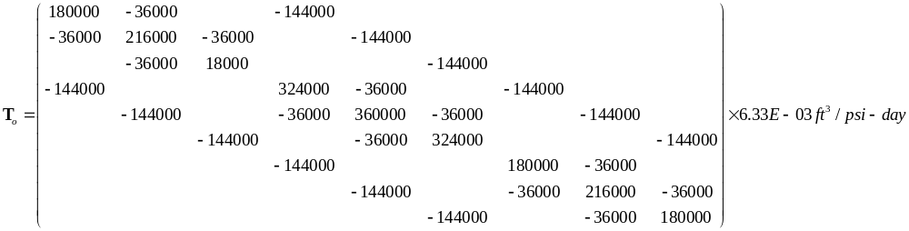

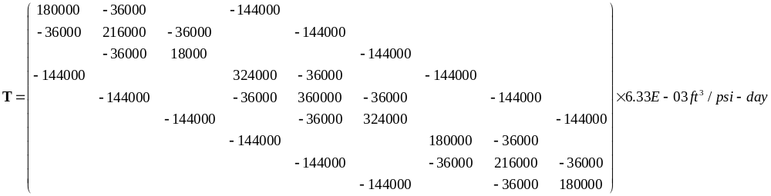
Solution at First Time Step

Slide 21
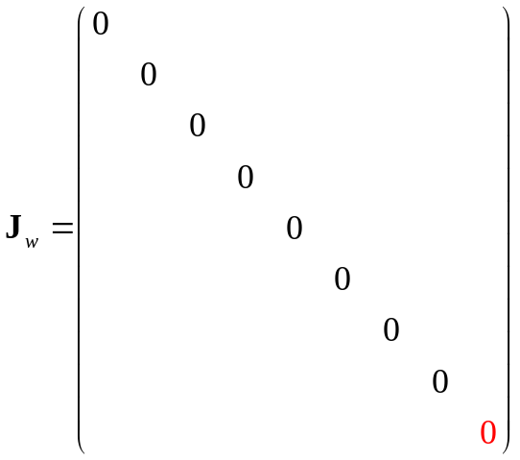
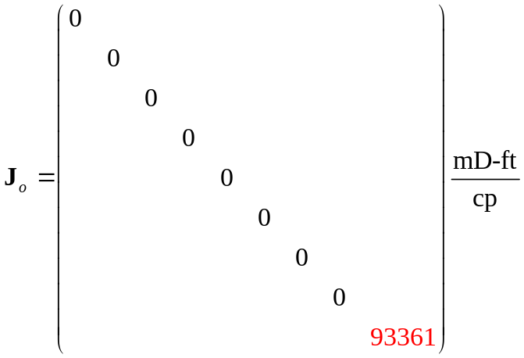

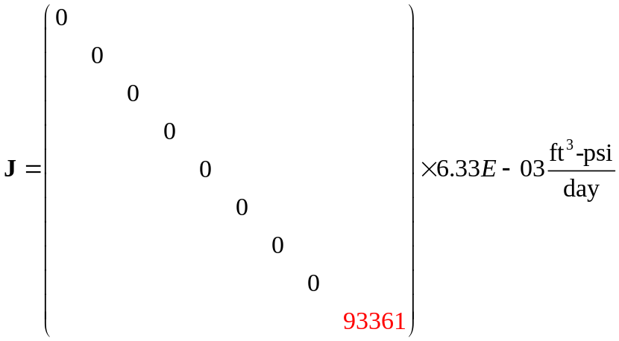
Solution at First Time Step

Slide 22
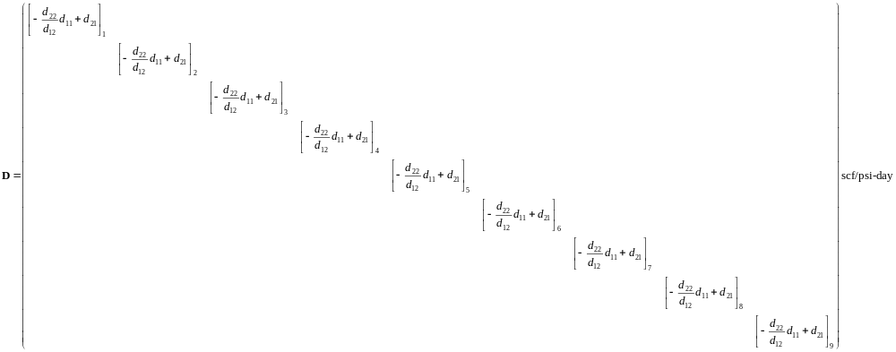
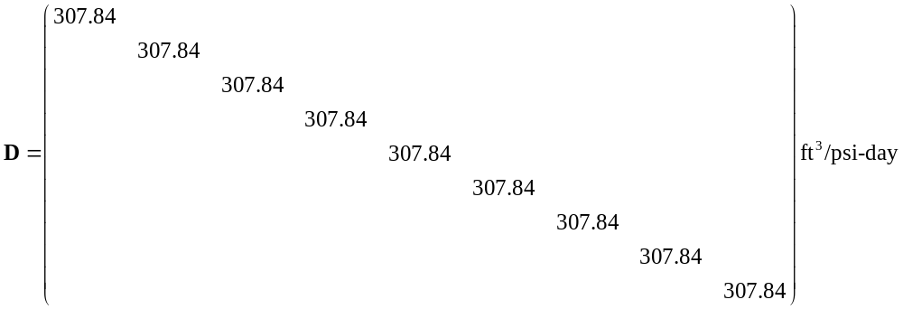
Solution at First Time Step

Slide 23
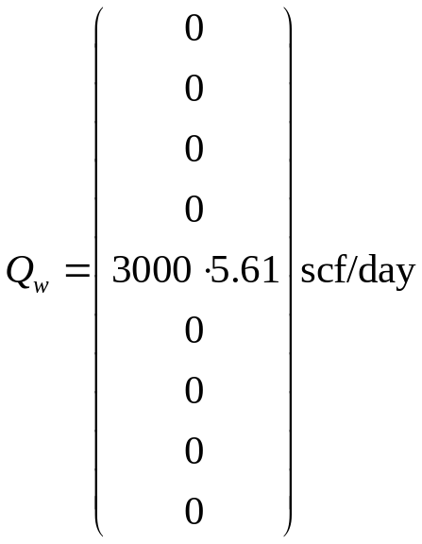
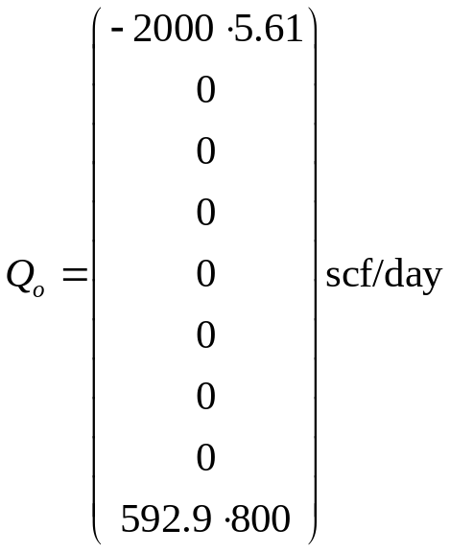
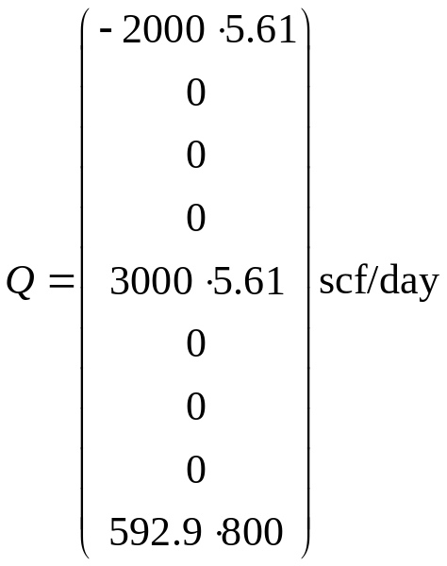

Solution at First Time Step

Slide 24
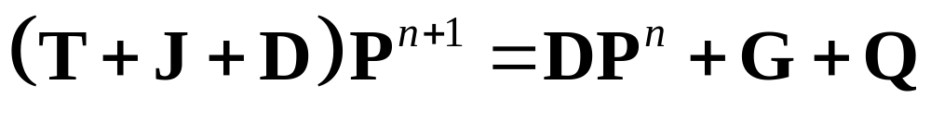
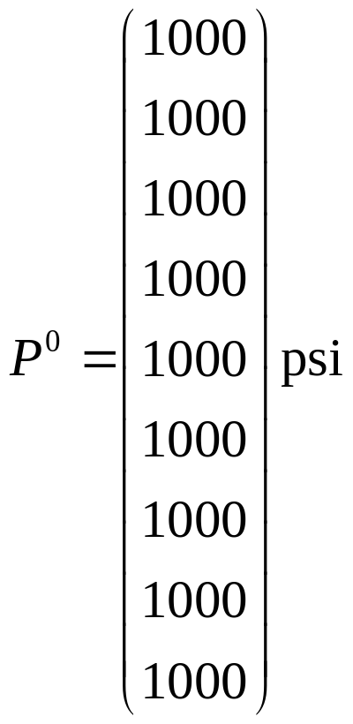
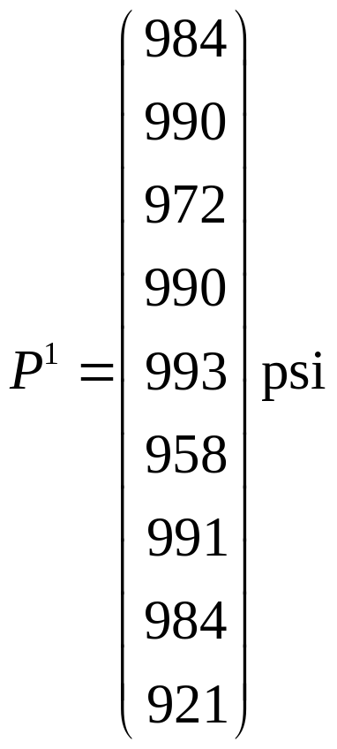
Solution at First Time Step

Slide 25
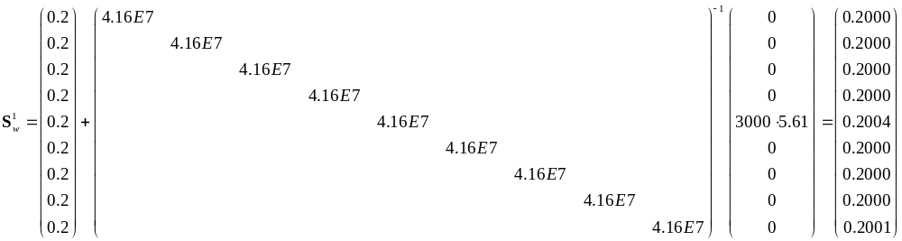
Update Saturations
Usually negligible
Zero Transmissibility; Sw=Swr
* Only if pressure “accumulation term” included; represents expansion of fluids

Slide 26
Solution at 1st Time Step
P = 991 psi
Sw = 0.2000
P = 984 psi
Sw = 0.2000
P = 921 psi
Sw = 0.20007856
P = 990 psi
Sw = 0.2000
P = 993 psi
Sw = 0.2004
P = 958 psi
Sw = 0.2000
j
P = 984 psi
Sw = 0.2000
P = 990 psi
Sw = 0.2000
P = 972 psi
Sw = 0.2000
i

Slide 27
Second Time Step is more complicated
T_{w} is not zero, because we are above residual water saturation
Transmissibilities vary from grid to grid
  Relative permeability not uniform
  Upwinding necessary!
Accumulation matrix (D’s) also varies from grid to grid

Slide 28
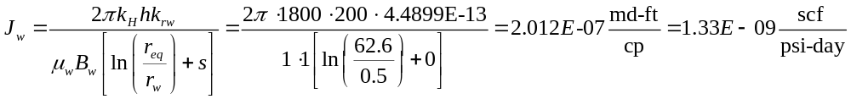
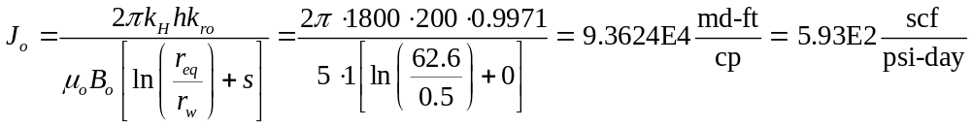
Update Productivity Indices
Peaceman Correction
Productivity Indices (for block #9)

Slide 29
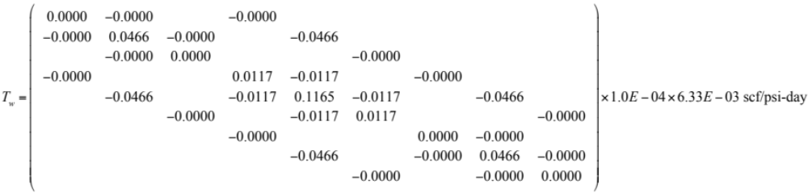
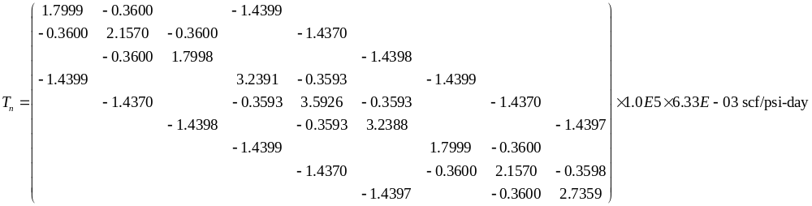
Trans Matrices at Second Time Step-with correction

Slide 30
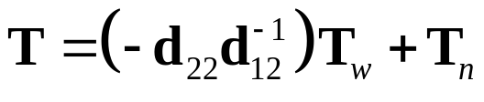
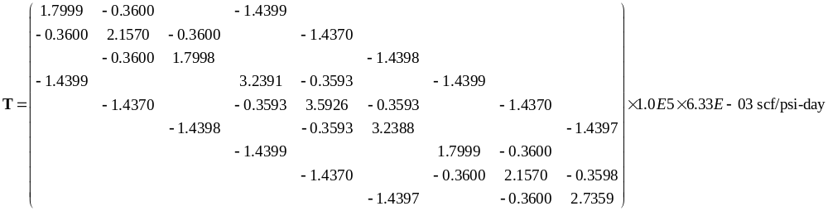
Trans Matrix at Second Time Step
Note: Tw was so small that T ~ To

Slide 31

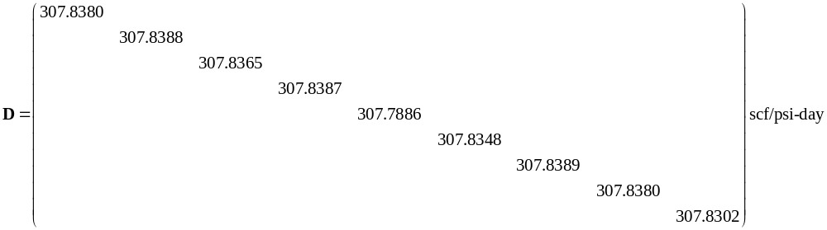
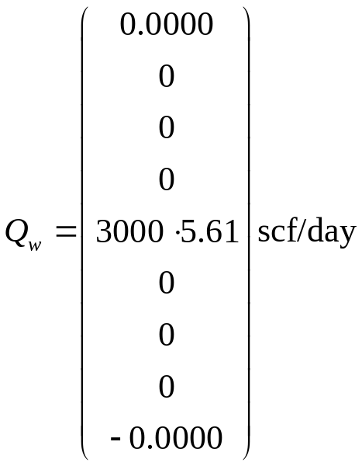
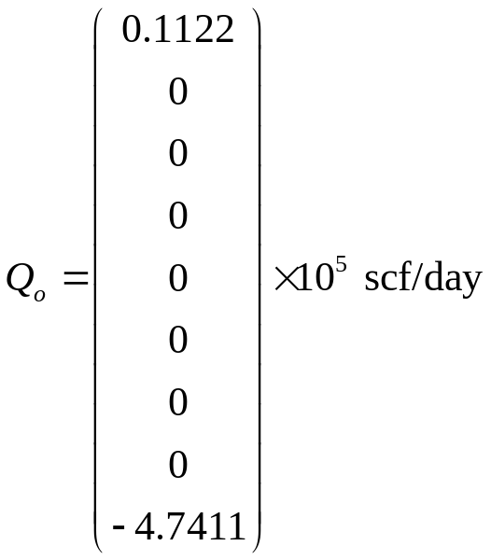
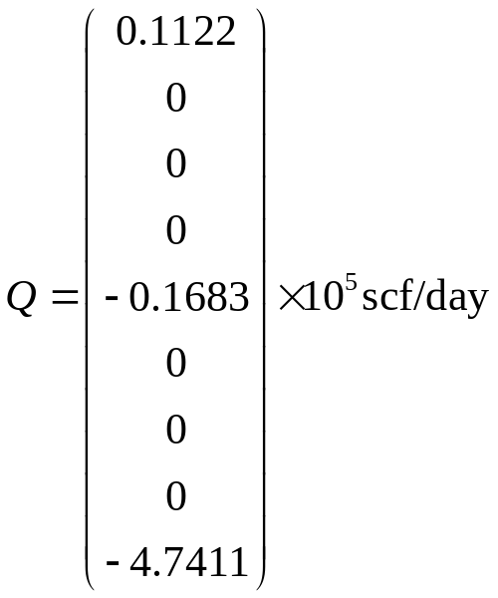
D Matrix at Second Time Step

Slide 32
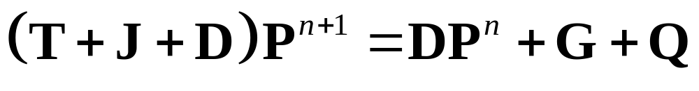
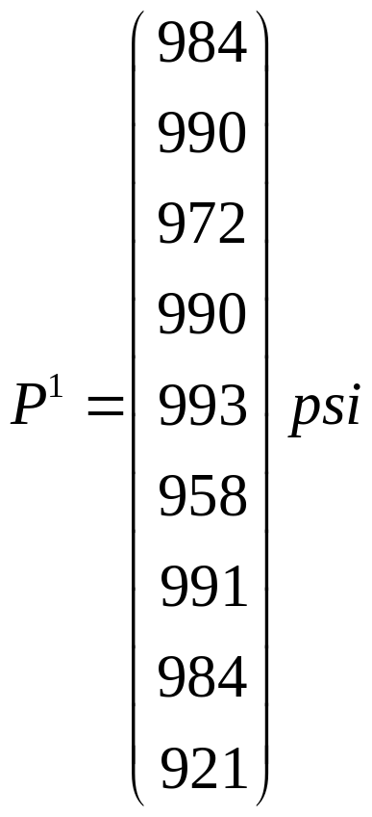
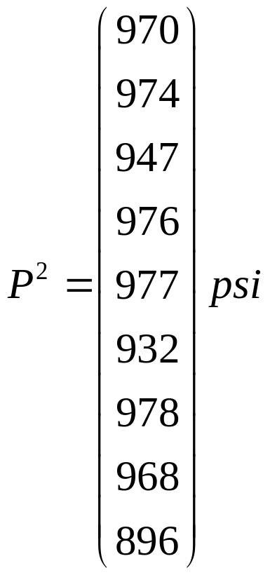
Solution at Second Time Step

Slide 33
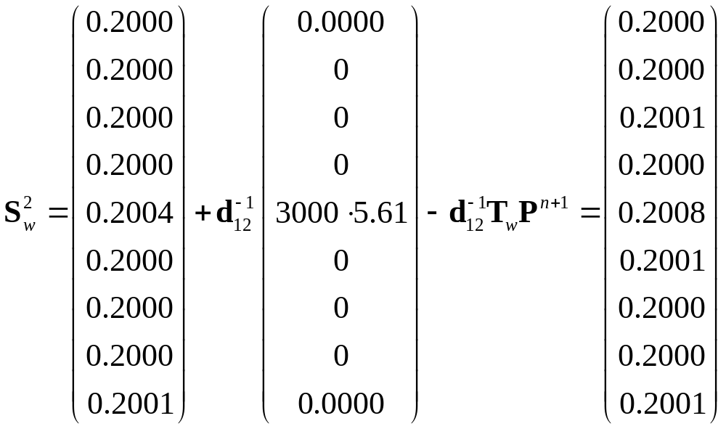
Update Saturations
Usually negligible (but should include to be thorough)

Slide 34
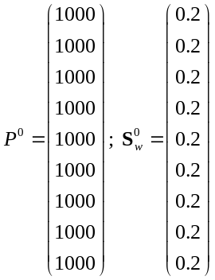
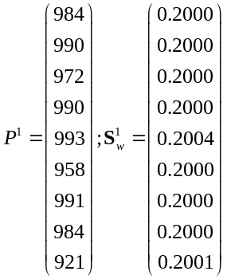
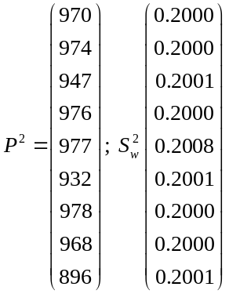
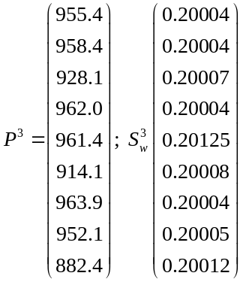
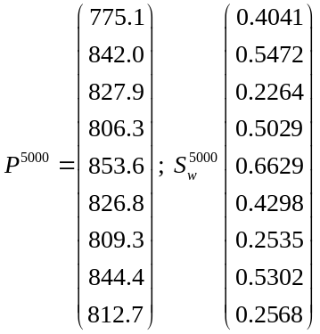
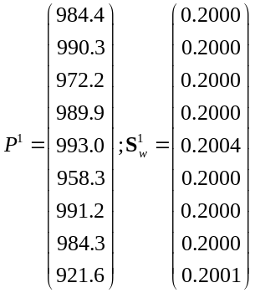
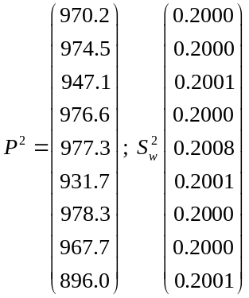


IMPES Summary
“Hand” (Matlab) Solution
t=0 days
t=0.1 days
t=0.2 days
t=0.3 days
t=500 days
CMG Solution
t=0 days
t=0.1 days
t=0.2 days
t=0.3 days
t=500 days

Slide 35
SS METHOD

Slide 36



Solution at First Time Step

Slide 37


Solution at First Time Step

Slide 38


Solution at First Time Step

Slide 39


Solution at First Time Step

Slide 40
Solution at 1st Time Step
P = 991 psi
Sw = 0.2000
P = 984 psi
Sw = 0.2000
P = 921 psi
Sw = 0.2001
P = 990 psi
Sw = 0.2000
P = 993 psi
Sw = 0.2004
P = 958 psi
Sw = 0.2000
j
P = 984 psi
Sw = 0.2000
P = 990 psi
Sw = 0.2000
P = 972 psi
Sw = 0.2000
i

Slide 41

SS Summary (almost identical to IMPES)
“Hand” (Matlab) Solution
t=0 days
t=0.1 days
t=0.2 days
t=0.3 days
t=500 days

